Slide 1
Quiz 1. menus and entry in capi
Ghana malaria indicator survey, 2016

Slide 2
In a blank paper, please write:
Your Field Worker (FW) code
Your name
Today’s date
Quiz 1

Slide 3
1. At any time during data collection, can interviewers write notes?
Yes, notes can be written for any question
No, notes can only be written for comments at the end of each questionnaire (household, woman, biomarker)
Yes, notes can be written for any question as well as for comments at the end of each questionnaire
None of the above

Slide 4
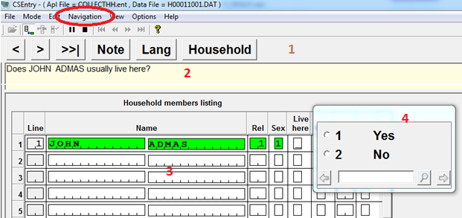
2. Identify the “area for question”, from where interviewers are supposed to read the question to the respondent.

Slide 5
3. When navigating in the capi data entry application, interviewers could use the following key to “go to” a field or question:
F10
F6
F5

Slide 6
4. To “go to” a field or question, interviewers need to know that:
QH FOLLOWED BY QUESTION NUMBER ARE QUESTION NAMES IN THE HOUSEHOLD
Q FOLLOWED BY QUESTION NUMBER ARE QUESTION NAMES IN THE WOMAN
QB FOLLOWED BY QUESTION NUMBER ARE QUESTION NAMES FOR THE BIOMARKER
ALL OF THE ABOVE

Slide 7
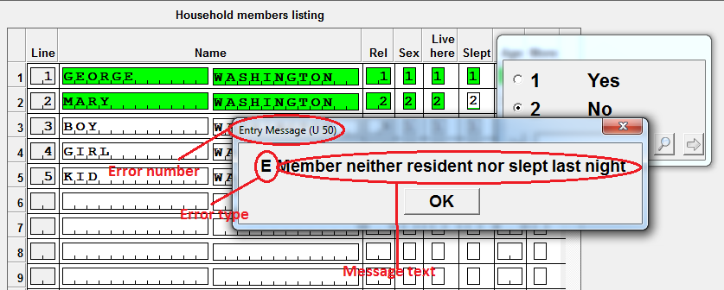
5. IS it MANDATORY TO CORRECT THE FOLLOWING ERROR MESSAGE?
Yes
No

Slide 8
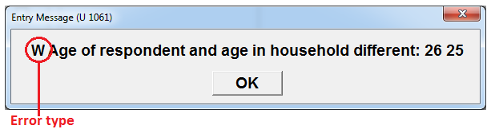
6. What is the type of message displayed in the image below:
Error message
Entry message
Warning message
This is not a message, it is an error of the CAPI data entry system and interviewers only need to click Ok

Slide 9
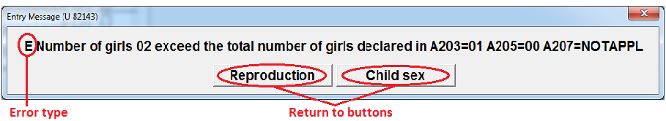
7. The following error message offers options TO CORRECT AN ERROR IN THE DATA, which are:
a. RETURN TO CORRECT REPRODUCTION SECTION
b. RETURN TO CORRECT CHILD SEX
c. RETURN TO CORRECT REPRODUCTION SECTION AND CHILD SEX
d. RETURN TO CORRECT REPRODUCTION SECTION OR CHILD SEX

Slide 10
8. WHY IS IT SO IMPORTANT TO ENTER THE CORRECT SUPERVISOR/INTERVIEWER/CLUSTER IN THE INTERVIEWER OR SUPERVISOR MENUS:
This information is used for the data file names
This information is used to located the households that interviewers need to visit
This information is used to run report in the specific cluster from the supervisor menu
This information is used to transfer the correct assignments for a particular cluster
This information is used to transfer the data files for a specific cluster/ interviewer(s)
This information is used to share data among the team
All of the above

Slide 11
9. In the Ghana mis 2016, In order to backup the data collected after interviewing, what device need to be plugged into the tablet before finishing the household or woman interview?
The USB flash disk
The SD card
Both
No device needed, the information is saved in the tablet hard disk

